Slide 1
Title of the project
Under guidance of
Dr. MURUGAN K,
Assistant Professor II,
BIT,
Sathy.
Shri Karun Mathesh S (191EE218)
Suresh (191EE232)
Vasanth Balaji V (191EE243)
Siranjivi J (192IT236)

Slide 2
Abstract
We developed an IoT based gesture controlled car that takes readings from an accelerometer which is placed on a human hand. The direction of the car can be changed by moving the hand in a particular direction, each movement generates the values in its corresponding axis. Generated values by accelerometer are sent to the Arduino UNO, HT12E encoder which is connected to Arduino will encode the values and send it to a receiver through RF433 transmitter. HT12D placed on the car will decode the values and give it to the L298 motor driver, which will instruct the motors to move the vehicle accordingly. This project can be very helpful for physically challenged people as they can move certain objects with less physical movement. The further addition to this project is that the control of the car can be done by an analog stick or joystick.

Slide 3
Problem Statement Addressed
i) Driving Four Wheelers is very Difficult for physically challenged people.
ii) Workers getting Injured (in some cases casualties) while working in construction sites.
iii) Potential Risks of Bomb Squads during Diffusing Bombs.

Slide 4
Existing Solution to the Problem Addressed
i) Special devices or gadgets like auto transmission, grip assembly, accelerator pedals, hand control, etc.
ii) Safety Helmets, Protective gear and safety training for workers.
iii) Protective suits for the Members to protect themselves.

Slide 5
Proposed Solution to the Problem Addressed
This solution proposes that,
This project can be very helpful for physically challenged people as they can move certain objects with less physical movement.
The introduction of IoT and combination of IoT and physical devices makes life easier. The tasks which are dangerous and hazardous can be done very easily. The introduction of IoT also completes the tasks in a very short duration of time. Moreover, the human errors are reduced on a great scale and results are achieved with great accuracy.

Slide 6
Project Work Plan
First we build the base of the car by using the wood and with the help gear motors we place the motors in the wood. Next we build the schematic circuit in the proteus software and we make it in the dot board with the help of soldering machine.
we build the source code for the transmitter and receiver circuit in the arduino IDE software.
then we upload the code in the arduino uno board and trail in the hardware part.

Slide 7
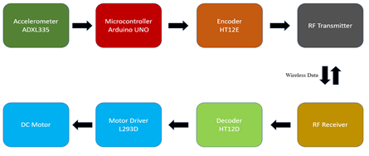
Block Diagram and/or Circuit Diagram

Slide 8
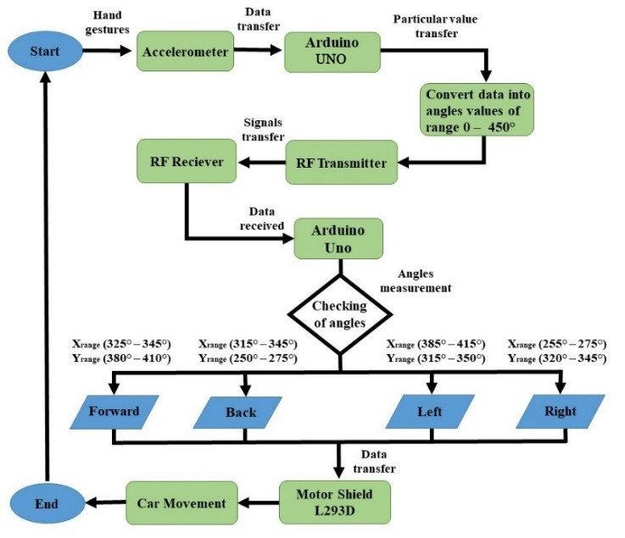
Flow Chart

Slide 9
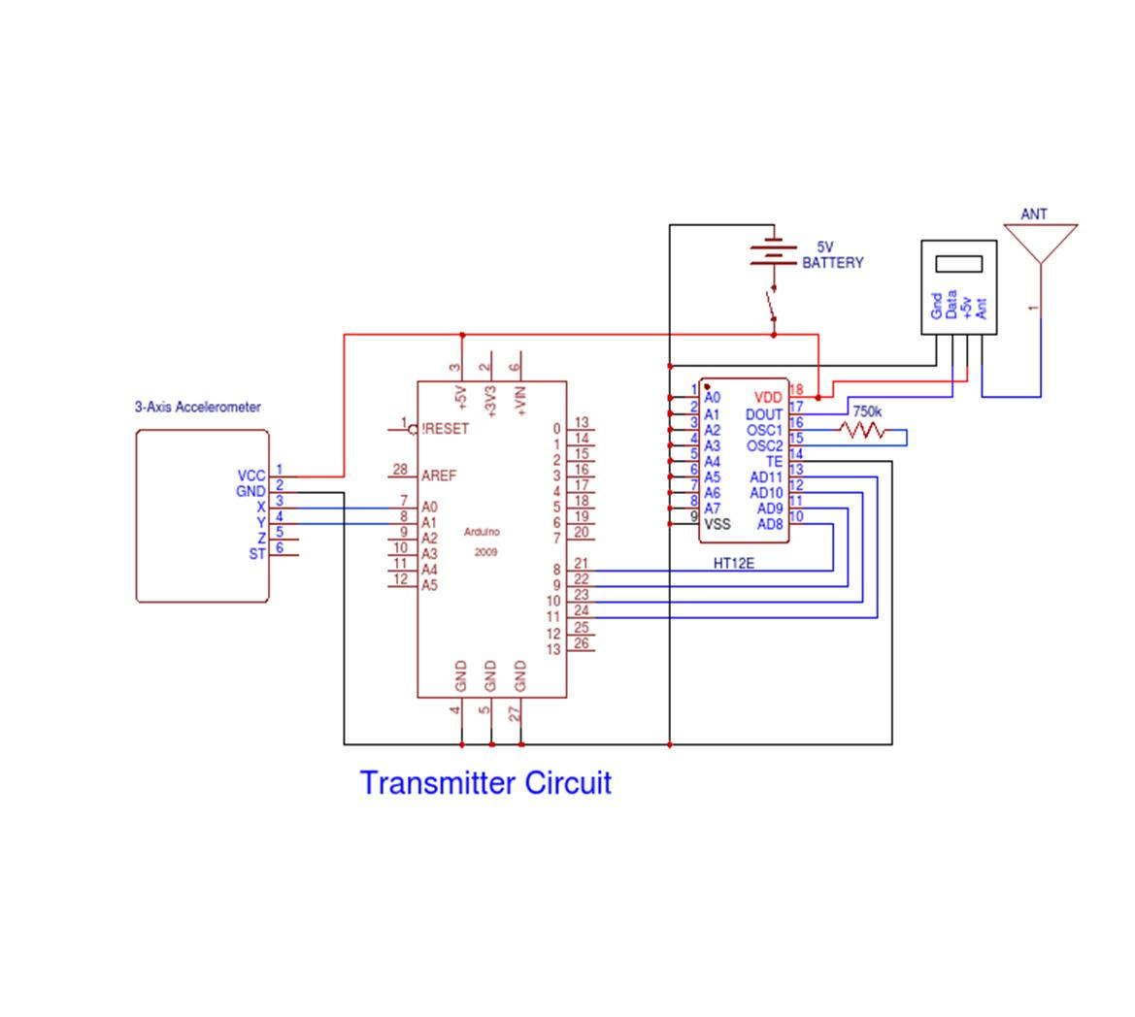
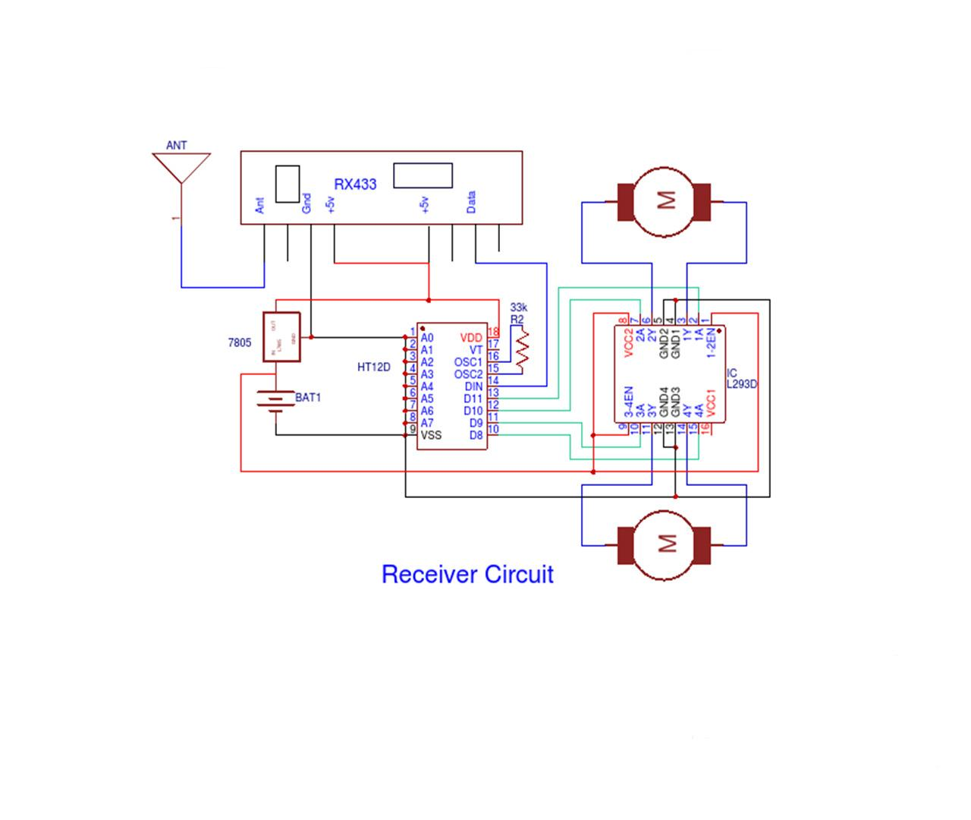
Prototype & Sample Output

Slide 10
Analysis of Results & Discussions
•Connect and communicate with physical devices: IoT facilitates the communication between human and machine.
•Faster and Smart innovation: Speed is very crucial aspect of any tool. Because of use of sensors in IoT devices the required output is given in a good speed with great accuracy.
We can manifest very little movement on very large scale. In this way, we can do maximum work which requires minimum human energy

Slide 11
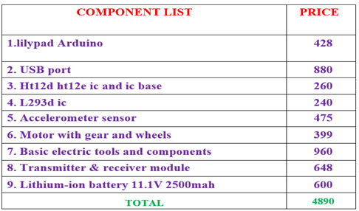
Cost Benefit Analysis (List of Components / Service Used)

Slide 12

Working video Link (If available)

Slide 13
References
[1] k.Ashok Kumar, K. Thamiz harasi, "GESTURE CONTROLLED ROBOT USING MEMS ACCELEROMETER FOR ERADICATION OF WEEDS", Indian Journal Of Science and Technology,Volume-8,Issue-5,March-2015. [2] Mir Gulam Mohin Uddin, Md. Abu Bakkar Chiddik, Tanbir Bakth Nabil, Emad Uddin Ahmed, "DESIGN AND IMPLEMENTATION OF ROBOTIC VEHICLE CAN BE CONTROLLED USING HAND GESTURE", International Journal Of Scientific Engineering and Research(IJSER),volume-3,Issue-3,Marcch-2015.

